Slide 1
Hitting the Nail on the Head
Jennifer Rexford Princeton University

Slide 2
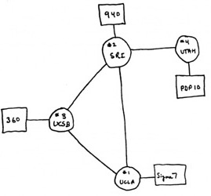
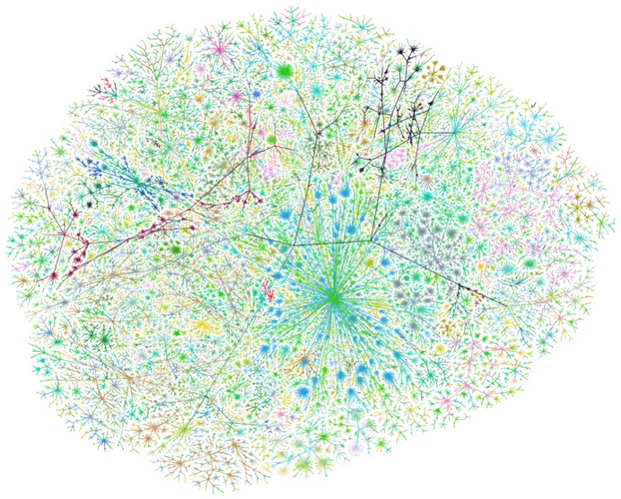
The Internet: An Exciting Time
One of the most influential inventions of all time
A research experiment that escaped from the lab
… to become a global communications infrastructure

Slide 3
Near-Constant Innovation
Applications
Internet
Hosts
Media

Slide 4
A Grand Challenge
Computer networks we can depend on
Performance, reliability, security, privacy, fairness, efficiency, autonomy, cost-effectiveness, …
Build strong intellectual foundations
Better real-world networks
... even as technology changes
We cannot do it alone!
Notes:
Networking tuned to today’s technology. What theory does is give you something of enduring value that will survive as technology changes.

Slide 5


Hammers and Nails
meet
Rich set of hairy research problems
Effective solution techniques
Notes:
Doesn’t happen without people

Slide 6
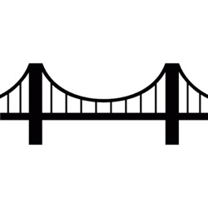
My Upbringing at
Algorithms, Optimization, Statistics
Network operations
networking
research
model
measure
control
Albert Greenberg
Taking existing network as a given…
Notes:
Measuring, model, and control
Taking existing network protocols and mechanisms as a given…

Slide 7
Three Example Projects
High-level policies
Programming languages
Distributed protocols
Optimization theory
Traffic monitoring
Compact data structures
Notes:
But I’ll go in chronological order…

Slide 8
Protocols as Distributed Optimizers (optimization theory)
Mung Chiang
Jiayue He, Rui Zhang-Shen, Ying Li, Cheng-Yen Lee, Jennifer Rexford, and Mung Chiang, "DaVinci: Dynamically Adaptive Virtual Networks for a Customized Internet,” in ACM SIGCOMM CoNext Conference, December 2008.
Notes:
Change the title to be broader?

Slide 9
Traditional Traffic Management
How much traffic should traverse each path?
Operator:
Traffic Engineering
(minimize congestion)
End hosts:
Congestion Control
(maximize utility, ensure fairness)
Routers:
Routing Protocol
(compute short paths)
Notes:
Mechanisms, designed independently

Slide 10
Architectural Limitations
Protocol interactions
Slow adaptation
Traffic engineering on longer timescale
One-size-fits-all performance metrics
Throughput vs. delay-sensitive traffic
Change traffic
Congestion
control
Traffic engineering
Change routes
max utility
min congestion

Slide 11
TCP as Network Utility Maximization
Reverse engineering the problem TCP solves
Utility U(x_{i}) as function of sending rate x_{i}
Objective max ∑_{i}U(x_{i}) subject to link capacities c_{l}
Utility
U(x_{i})
Sending rate x_{i}
x₁
c_{l}
x₂

Slide 12
Designing Traffic Management
Forward engineering of traffic management
Maximize total utility: max ∑_{i}U(x_{i})
Routing as a variable: traffic z_{ij} on path j
z_{i1}
Source i
x_{i} = z_{i1} + z_{i2}
z_{i2}

Slide 13
Distributed Protocol
Decompose to generate a distributed solution
Each link computes congestion “price” p_{l}
Each source computes path rates z_{ij} to maximize utility (U(∑_{j} z_{ij})) subject to path cost (sum over p_{l})
p
p
p
Routers:
Set up multiple paths
Measure link load
Update link prices p
Sources:
Update path rates z
Rate limit incoming traffic

Slide 14
Multiple Traffic Classes
Utility functions
Max throughput (U₁())
Min latency (U₂())
Bandwidth shares
Share y_{1l} and y_{2l} on link l
Where y_{1l} + y_{2l} = c_{l}
max w₁ ∑_{i} U₁() + w₂ ∑_{i} U₂()
y_{2l}
3
two virtual networks
y_{1l}
1
2

Slide 15
Two-Stage Decomposition
max w₁ ∑_{i} U₁() + w₂ ∑_{i} U₂()
max ∑_{i} U₁()
subject to y_{1l}
max ∑_{i} U₂()
subject to y_{2l}
Link bandwidth c_{l} reallocated between y_{1l} and y_{2l}
periodically based on congestion prices of VNs
Notes:
Show the bandwidth shares between the two optimization problems.
Connect to primal and dual decomposition?

Slide 16
Lesson: Protocols as Optimizers
Start with a well-stated (optimization) problem
Then decompose into a distributed solution
Benefits
Deeper understanding of how protocols work
Guarantees on optimality, convergence, etc.
In reality, the process is iterative

Slide 17

Lesson: Research as Decomposition ☺
The network needs to solve this problem.
Too hard, please change the network.
Okay, how about this?
Make per-class convergence faster
Change objective to include link utilization u_{l}
… include both TCP utility and TE congestion!
max (∑_{i} U(x_{i}) - ∑_{l} f(u_{l} /c_{l}))
Notes:
Goal is not novel optimization theory. Quite the contrary.

Slide 18
Lesson: Research as Decomposition ☺
The network needs to solve this problem.
Too hard, please change the network.
Okay, how about this?
Make the multi-class problem tractable
Separate queue for each traffic class per link
... to decouple the per-class utility functions!
y_{1l}
c_{l}
y_{2l}

Slide 19
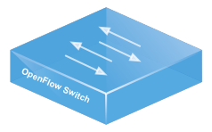
Lesson: People and Timing
The right graduate students
Comfortable with both topics
Able to wrangle two busy advisors
The right timing (eventually?)
Programmable switch hardware
Notes:
Put the two “exception” examples in the dialogue…

Slide 20
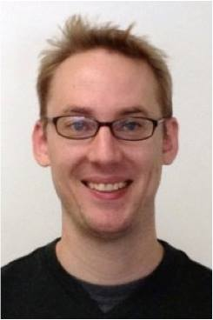
Composition of Network Policies (programming languages)
David Walker
Nate Foster
Nate Foster, Michael J. Freedman, Arjun Guha, Rob Harrison, Naga Praveen Katta, Christopher Monsanto, Joshua Reich, Mark Reitblatt, Jennifer Rexford, Cole Schlesinger, Alec Story, and David Walker, "Languages for software-defined networks," IEEE Communications Magazine, Feb 2013.

Slide 21
Software-Defined Networking (SDN)
Network-wide visibility and control
Controller Application
Controller Platform
Direct control via open interface
From distributed protocols to (centralized) controller applications
Notes:
Network-wide visibility and control
Direct control via an open interface

Slide 22

Simple, Open Data-Plane API
Prioritized list of rules
Pattern: match packet header bits
Actions: drop, forward, modify, send to controller
Priority: disambiguate overlapping patterns
Counters: #bytes and #packets
srcip=1.2.*.*, dstip=3.4.5.* → drop
srcip = *.*.*.*, dstip=3.4.*.* → forward(2)
3. srcip=10.1.2.3, dstip=*.*.*.* → send to controller
Notes:
Defined in terms of a protocol and mechanism
Clarify that each packet matches exactly one rule (the highest priority one that matches). Primitive execution engine.

Slide 23
Writing SDN Controller Applications
Controller Application
Programming abstractions
Controller Platform
OpenFlow protocol
OpenFlow is a mechanism, not a linguistic formalism.

Slide 24
Combining Many Networking Tasks
Monolithic application
Route + Monitor + FW + LB
Controller Platform
Hard to program, test, debug, reuse, port, …

Slide 25
Modular Controller Applications
Each module partially specifies the handling of the traffic
Monitor
Route
FW
LB
Controller Platform

Slide 26
Abstract OpenFlow: Policy as a Function
Located packet
Packet header fields
Packet location (e.g., switch and port)
Function of a located packet
To a set of located packets
Drop, forward, multicast
Packet modifications
Change in header fields and/or location
0
2
1
3
dstip == 1.2.3.4 & srcport == 80 → port = 3, dstip = 10.0.0.1
Notes:
Abstraction of OpenFlow, boolean predicates instead of bit twiddling and rules
In PL historically, look to define the meaning of programs using “denotational semantics” (one that is compositional).
Programmer doesn’t have to look at the syntax to understand.
Goes back to Dana Scott in the 1960s.
Meaning of something as a combination of the meanings of the two parts. Applied those lessons here to networking.
So, functions of located packets is the primitive building block.

Slide 27
Parallel Composition (+)
srcip == 5.6.7.8 → count
srcip == 5.6.7.9 → count
dstip == 1.2/16 → fwd(1)
dstip == 3.4.5/24 → fwd(2)
Monitor on source IP
+
Route on dest prefix
Controller Platform
srcip == 5.6.7.8, dstip == 1.2/16 → fwd(1), count
srcip == 5.6.7.8, dstip == 3.4.5/24 → fwd(2), count
srcip == 5.6.7.9, dstip == 1.2/16 → fwd(1), count
srcip == 5.6.7.9, dstip == 3.4.5/24 → fwd(2), count

Slide 28


Example: Server Load Balancer
Spread client traffic over server replicas
Public IP address for the service
Split traffic based on client IP
Rewrite the server IP address
Then, route to the replica
10.0.0.1
10.0.0.2
1.2.3.4
clients
load balancer
10.0.0.3
server replicas

Slide 29
Sequential Composition (>>)
srcip==0*, dstip==1.2.3.4 → dstip=10.0.0.1
srcip==1*, dstip==1.2.3.4 → dstip=10.0.0.2
dstip==10.0.0.1 → fwd(1)
dstip==10.0.0.2 → fwd(2)
Load Balancer
>>
Routing
Controller Platform
srcip==0*, dstip==1.2.3.4 → dstip = 10.0.0.1, fwd(1)
srcip==1*, dstip==1.2.3.4 → dstip = 10.0.0.2, fwd(2)
Notes:
Load balancer splits traffic sent to public IP address over multiple replicas, based on client IP address, and rewrites the IP address

Slide 30
Lessons: Abstraction and Composition
OpenFlow was an important first step
Generalizes many networking devices
Easy to explain to non-experts
Thinking compositionally
Precisely defining the meaning of programs
Creating simple, reusable building blocks
NetKAT: Network Kleene Algebra with Test
Abstractions for the “control loop”
Measure, decide, and update
decide
measure
update
Notes:
NetKAT: a good example of new PL research

Slide 31
Lessons: Embedded People (and Code)
Nate Foster’s postdoc at Princeton
Embedded in the networking group
Learning by doing
Writing SDN apps in NOX
… and then the abstractions followed
Recruiting others
Open-source software and tutorials
Presentations, summer school, collaborations
Publishing in both PL and networking venues
Thinking ahead: P4 language for new hardware

Slide 32
Traffic Monitoring in the Data Plane (compact data structures)
S. Muthukrishnan
Vibhaalakshmi Sivaraman, Srinivas Narayana, Ori Rottenstreich, S. Muthukrishnan, and Jennifer Rexford, "Heavy-hitter detection entirely in the data plane," in ACM Symposium on SDN Research, April 2017.

Slide 33
Programmable Packet Processing Hardware
Registers
Registers
Packet
parser
metadata
Match | Action
m1 | a1
Match | Action
m1 | a1
. . .
Match-action tables
Match-action tables

Slide 34
Traffic Analysis in the Data Plane
Streaming algorithms
Analyze traffic data
… directly as packets go by
A rich theory literature!
A great opportunity
Heavy-hitter flows
Denial-of-service attacks
Performance problems
...

Slide 35
A Constrained Computational Model
Small amount of memory
Registers
Registers
Packet
parser
metadata
Match | Action
m1 | a1
Match | Action
m1 | a1
. . .
Limited computation
Pipelined computation
Match-action tables
Match-action tables

Slide 36

Example: Heavy-Hitter Detection
Heavy hitters
The k largest trafic flows
Flows exceeding threshold T
Space-saving algorithm
Table of (key, value) pairs
Evict the key with the minimum value
Id | Count
K1 | 4
K2 | 2
K3 | 7
K4 | 10
K5 | 1
K6 | 5
New Key K7
Table scan

Slide 37
Approximating the Approximation
Evict minimum of d entries
Rather than minimum of all entries
E.g., with d = 2 hash functions
Id | Count
K1 | 4
K2 | 2
K3 | 7
K4 | 10
K5 | 1
K6 | 5
Multiple memory accesses
New Key K7

Slide 38
Approximating the Approximation
Divide the table over d stages
One memory access per stage
Two different hash functions
New Key K7
Id | Count
K1 | 4
K2 | 2
K3 | 7
Id | Count
K4 | 10
K5 | 1
K6 | 5
Going back to the first table

Slide 39
Approximating the Approximation
Rolling min across stages
Avoid recirculating the packet
… by carrying the minimum along the pipeline
Id | Count
K1 | 4
K2 | 10
K3 | 7
Id | Count
K4 | 2
K5 | 1
K6 | 5
Id | Count
K1 | 4
K7 | 1
K3 | 7
Id | Count
K2 | 10
K5 | 1
K6 | 5
New Key K7
(K2, 10)

Slide 40
P4 Prototype and Evaluation
Hash on packet header
Packet metadata
Register arrays
Id | Count
K1 | 4
K2 | 10
K3 | 7
Id | Count
K4 | 2
K5 | 1
K6 | 5
New Key K7
(K2, 10)
Conditional updates to compute minimum
High accuracy with overhead
proportional to # of heavy hitters

Slide 41
Lessons: Concrete vs. Abstract
Getting concrete
Computational model
Example problem (e.g., heavy hitters)
Strawman solution (e.g., space saving)
Iteratively designing
Relaxing the strawman solution
Striving for general understanding
Provable bounds on accuracy vs. overhead
Ways to approach other analysis questions

Slide 42
“If I Had a Hammer…”
Should we all do interdisciplinary research?

Slide 43
Interdisciplinary Fun
Intellectually exciting
Learn about other areas
Learn to think in new ways
Articulate your own field to others
Striving for big impact
Create novel solutions in your field
Bring new problems to another field
Real problems are often interdisciplinary
Socially fun
In-depth conversations
Not always about work ☺

Slide 44
Managing Risks
One vs. many hammers
I’ve been an opportunistic collaborator
But, mastering one hammer is sometimes better
Honing one hammer
Controlling your fate
Great grad school or postdoc adventure
Pick hammer wisely!
Work by collaboration
Riskier for junior folks
Okay if you dig deep in your own field
Pick nails wisely!
Notes:
“Pick wisely” – something you like, are good at, and applies to many problems
“Dig deep” – understand operational practices, technology and business trends, etc.

Slide 45
Managing Risks
Steep learning curve
Learning both the hammer and the nail
Learning the culture of both research fields
Start with the hammer
Easier for a PL person to learn (part of) networking
… than for a networking person to learn PL
Join an emerging community
Technical foundations and collaborators
Example projects and publications
But, don’t join too late in the game

Slide 46
Managing Risk
Credit for the work
Publications in different field’s venues
Multiple authors
Favoring publication venues for junior author
Understanding institution’s evaluation process
Can be easier to tell who’s “fingerprints” are on which parts of the work

Slide 47
Managing Risks
Healthy interdisciplinary collaborations
Collaborators who stay engaged
… and truly “dig in” to the work
Work that is exciting in both fields
Similar value structures (e.g., proofs, code)
Engaging students and postdocs
Physical proximity

Slide 48


Conclusion
Computer networking
Important real-world challenges
Intellectually rich space of problems
Networks worthy of society’s trust
Grand challenge across a range of fields
… if we can reach across the divide

